Slide 1
CS3210 Tutorial 6 / Lab 6
Interconnects

Slide 2
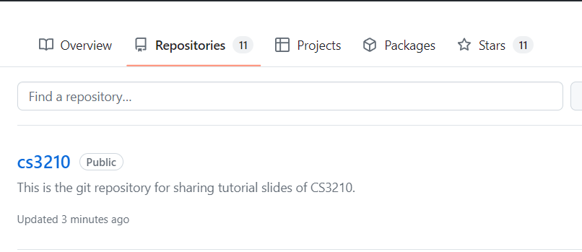
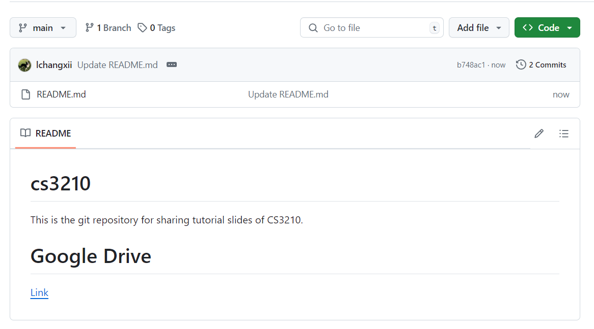
Questions and Slides Sharing
Slides
Github and Google Drive after every session.
https://github.com/lchangxii/cs3210
You can find the Link in the README if preferring Google Drive

Slide 3
Reviewing Interconnects

Slide 4
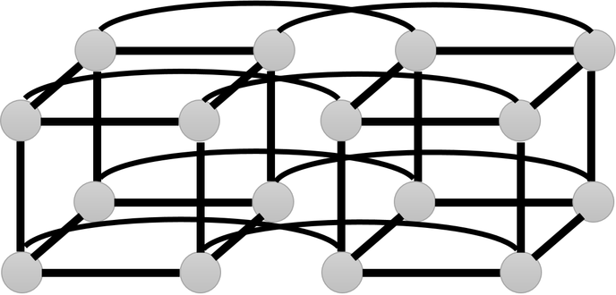
Why Interconnects?
Parallel computing ⇒ many separate processing elements (PEs)
These could be (non-exhaustive)
CPUs ⇔ Memory banks
CPU ⇔ CPU
Processor ⇔ Processor
Entire node ⇔ Entire node
We need to make an informed decision about how to connect them (as opposed to just YOLO it)

Slide 5
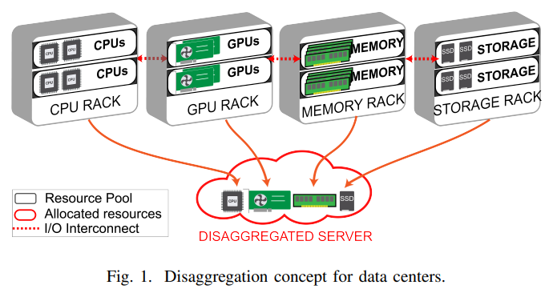
New Research: “Disaggregated Computing”
In datacenters: what if we separate out the CPUs, memory, GPUs.. into entirely different areas?
For more efficient resource allocation for jobs etc
Now even more possibilities for interconnection choices!
https://arxiv.org/pdf/2008.10802.pdf

Slide 6
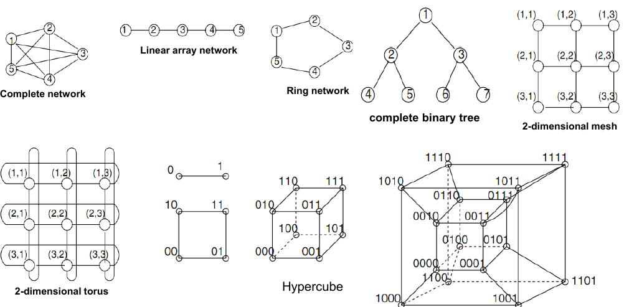
Interconnects: Many possibilities

Slide 7
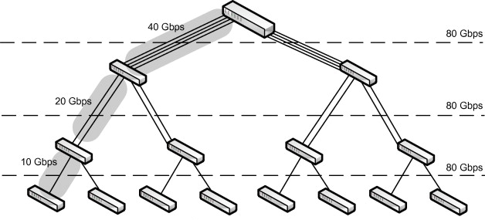

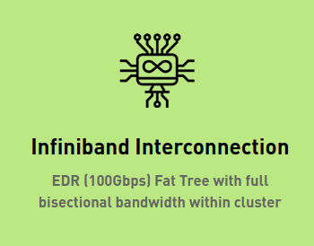
Real-world Interconnects
Singapore National Supercomputing Center ASPIRE 1 Supercomputer: Fat Tree
Goal: identical bandwidth between any two nodes
Downsides?
Notes:
Fat tree: very expensive

Slide 8
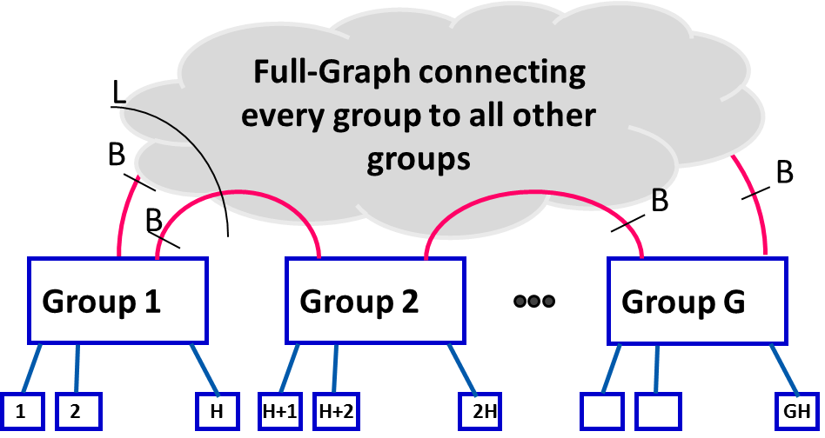
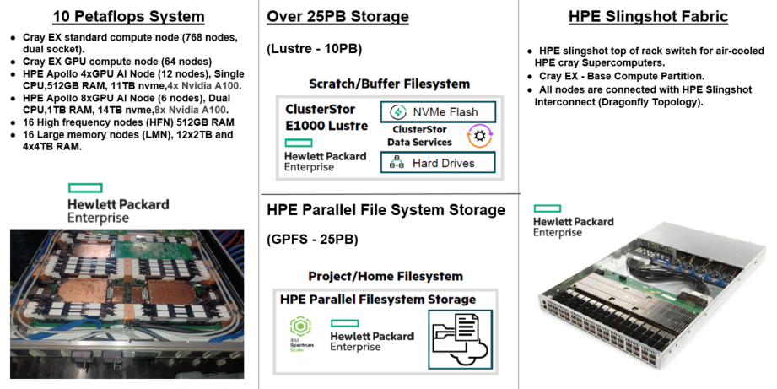
Real-world Interconnects
Singapore National Supercomputing Center ASPIRE 2A Supercomputer: Dragonfly
Goal: reduce cost via reducing long links and max #hops
Many “flavors”!
Notes:
Within-group interconnect topology is entirely up to deployer, etc
Many different Dragonflies

Slide 9
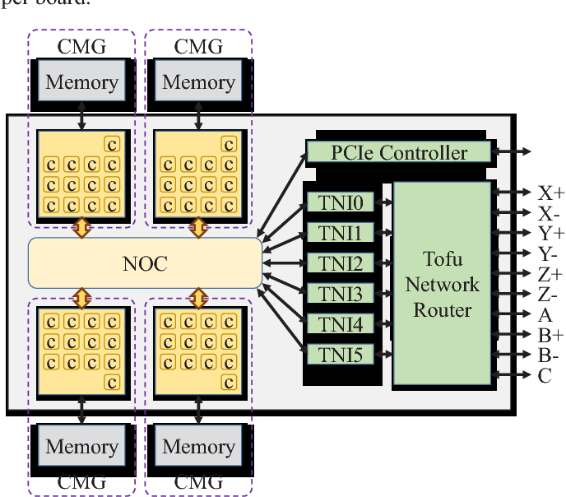
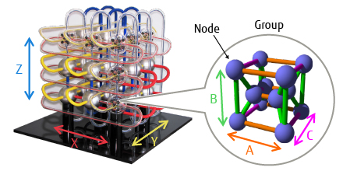
Real-world Interconnects
Japanese Fukagu Supercomputer: 6D Torus (Tofu: “Torus Fusion”)
Goal: high connectivity, scalable, fault tolerant
Notes:
Within-group interconnect topology is entirely up to deployer, etc
Many different Dragonflies

Slide 10
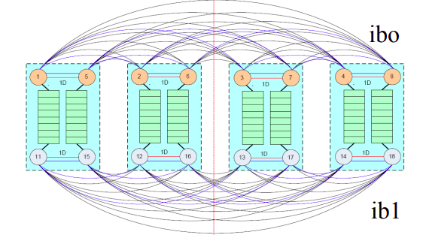
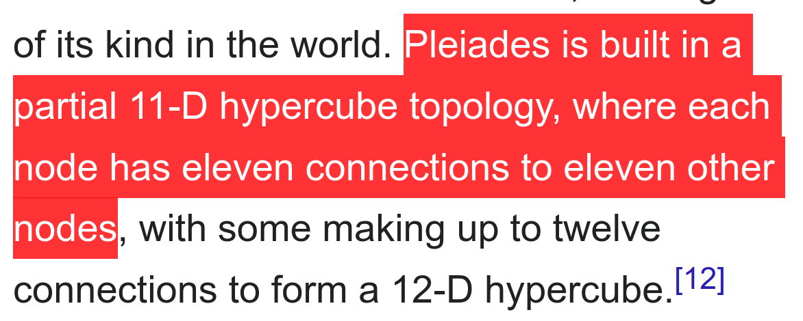
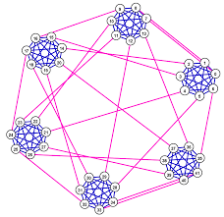
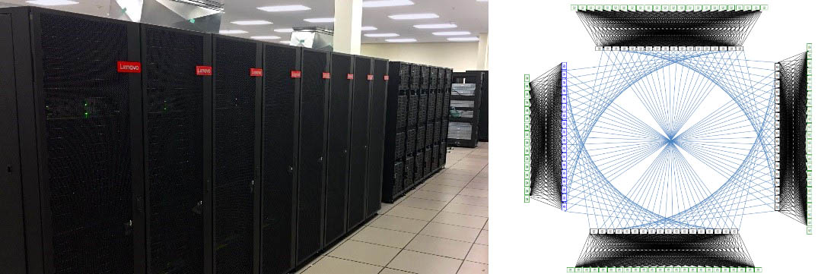
Real-world Interconnects
NASA Ames Pleiades: 11-D hypercube
Canadian Niagara Supercomputer: Dragonfly+ Network

Slide 11
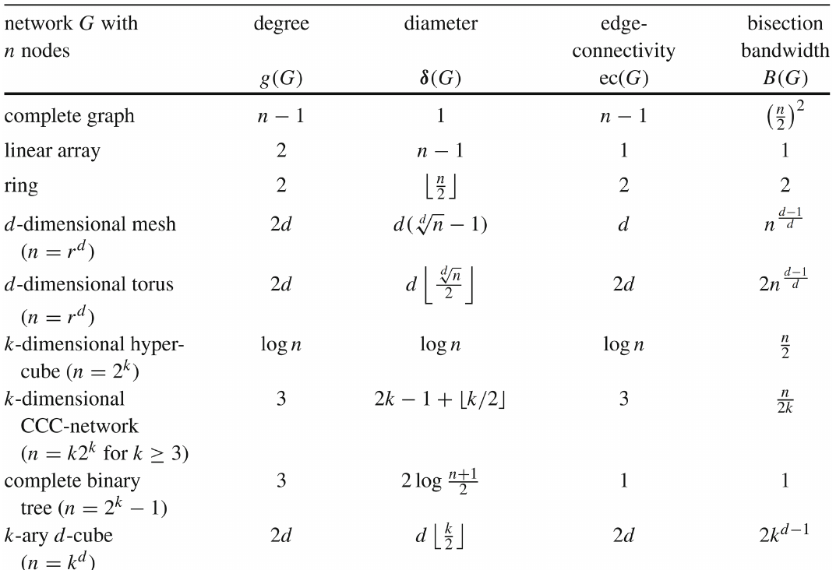
The golden reference: Lec11 Slide 36
Some notes:
Degree: maximum degree of a node (no. of links)
Diameter: “longest shortest path” that we can find between two nodes in the graph
Edge connectivity: how many edges to remove before network disconnects?
Bisection width: min edges to remove to split network into equal halves

Slide 12
Tutorial Questions

Slide 13
Q1: Direct Interconnect Routing

Slide 14
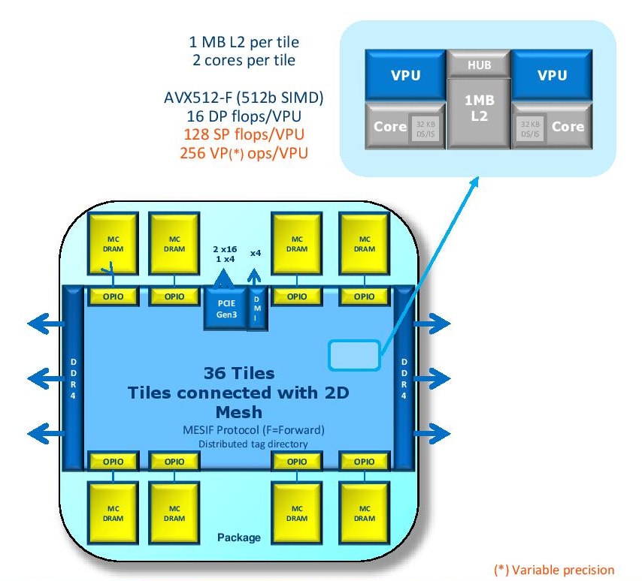
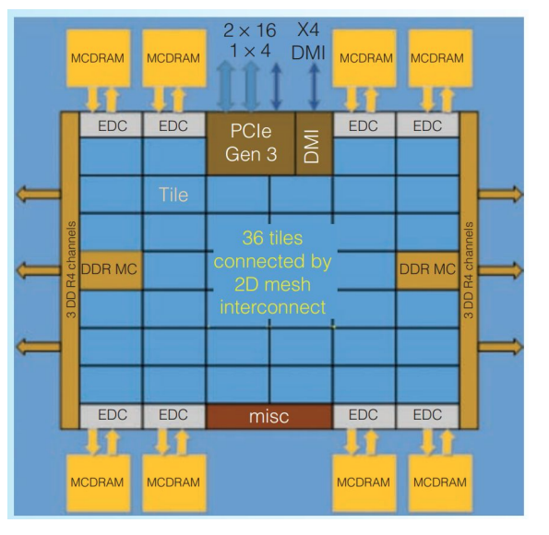
Intel Xeon Phi Co-Processor
72 core system, used by
2013 top supercomputer (Tianhe-2)
YX routing!

Slide 15
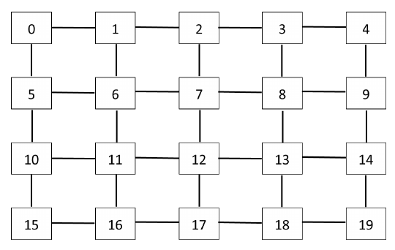
Q1: YX Routing
Here: messages move vertically, then horizontally
Each link can do 1 byte of data per clock
Node 0 sends 2 packets of 4 bytes each to Node 14
Node 11 sends 2 packets of 4 bytes each to Node 13
Important info: packets are not pipelined byte by byte
Send whole packet to next node first
Is there contention (queueing waiting for a link to be free? [p])

Slide 16
Q1: YX Routing
Tracing the messages from 0 → 14
Start T=0:
4 cycles for first packet 0 → 5
Start T=4:
4 cycles for first packet 5 → 10
Start T=8:
4 cycles for first packet 10 → 11
(snapshot at T=12)

Slide 17
Q1: YX Routing
Tracing the messages from 11 → 12 (eventually to 13)
Recall: first packet from 0 arrives at 11 by T = 12
T=0:
4 cycles for first packet 11 → 12
In fact, both of 11’s packets are received by 13 by T = 12
No contention!
T=4:
4 cycles for second packet 11 → 12
11 → 12 link is free from T = 8 onwards!

Slide 18
Why does this question matter?
Real, simple routing system used in real supercomputer processor!
“The mesh enforces a YX routing rule, which means a transaction always travels vertically first until it hits the target row, makes a turn, and then travels horizontally until it reaches its destination. Messages arbitrate with the existing traffic on the mesh at injection points as well as when making a turn, with the existing traffic on the mesh taking higher priority. The static YX routing helps reduce deadlock cases and thereby simplifies the protocol. One hop on mesh takes one clock in the Y direction and two clocks in the X direction.”
https://pages.cs.wisc.edu/~david/courses/cs758/Fall2016/handouts/restricted/Knights-landing.pdf

Slide 19
Q2

Slide 20
Q2: Indirect Interconnects: Omega
You want to connect 8 processing units and 8 memory units
If Omega network: how many stages and switches per stage? [p]

Slide 21
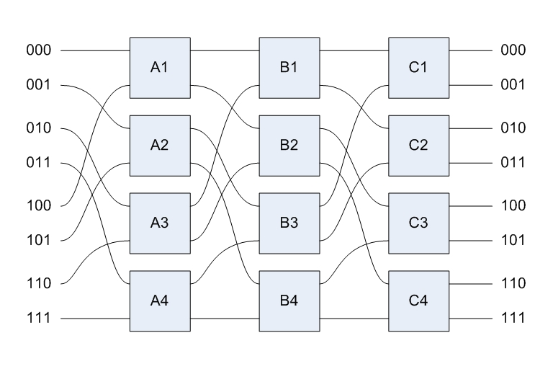
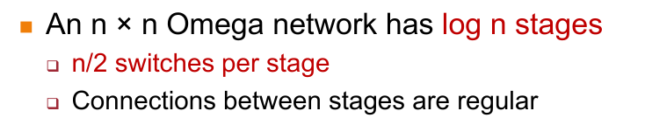
Q2: Indirect Interconnects: Omega
You want to connect 8 processing units and 8 memory units
If Omega network: how many stages and switches per stage? [p]
log₂(8) stages = 3 stages
n/2 switches per stage = 8/2 = 4 switches per stage

Slide 22
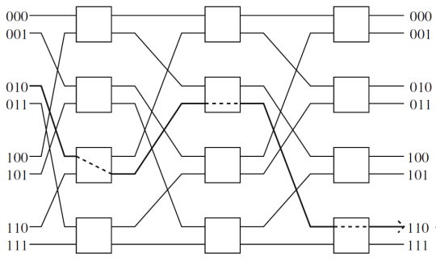
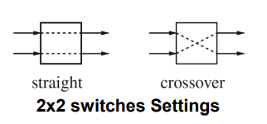
Q2: Indirect Interconnects: Omega
You want to send a packet from 101 to 100 with XOR-tag routing: how?
101 xor 100 = 001
Straight (0) → straight (0) → crossover (1)

Slide 23
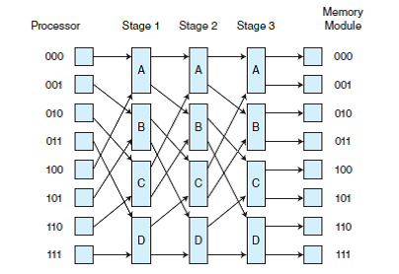
Why does this question matter?
Indirect interconnects have a lot of flexibility at the expense of cost / perhaps switching time
Sometimes preferred for heterogenous connections (e.g., CPU -> memory, etc)

Slide 24
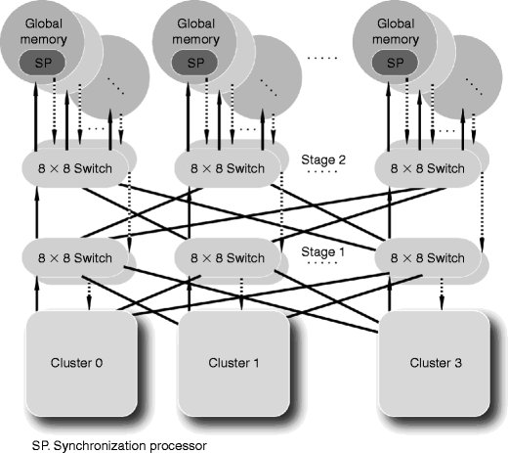
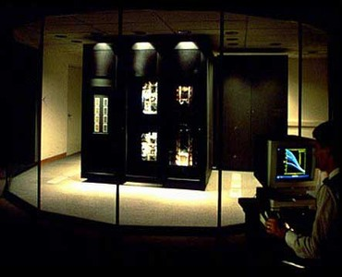
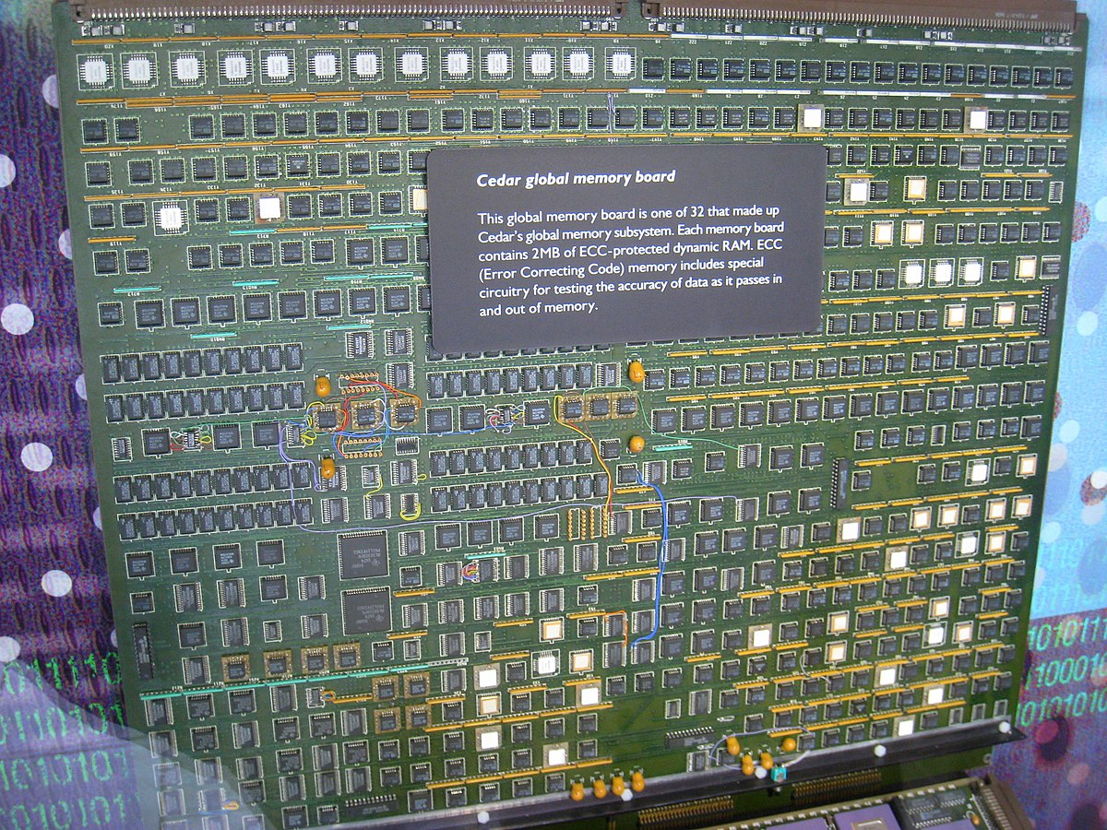
Examples
Illinois Cedar Multiprocessor
IBM RP3

Slide 25

Attendance
link

Slide 26
Lab 6 (Optional)

Slide 27
Lab 6: Benchmarking
Won’t go into too much detail, but quick overview
Goal: Run Serial/OpenMP/MPI NASA benchmark on Slurm and compare performance
Bonus 2% to get up to your 10% lab/tut grade (if fallen short somewhere)

Slide 28
Example of running Lab 6
cd -P ~/l6/code/OMP/
make is CLASS=B
export OMP_NUM_THREADS=4
srun -n1 -N1 bin/is.B.x
cd -P ~/l6/code/MPI/
make is NPROCS=4 CLASS=B
salloc -n4 -N4 mpirun bin/is.B.4

Slide 29
Where to go from here (perspective of a senior)
CS3230
STRONGLY RECOMMENDED as a prerequisite
CS5239
Deeper dive into theory of performance of computing systems
CS3210
CS4223
More hardware-focused than CS3210
(didn't take it as I'm allergic to hardware)
CS4231 ★
Learn theory of parallel algorithms
(Funny NUSMods reviews, still good to take)
CS3211 ★
Learn how different programming languages implement parallelism (git gud at modern C++, Go and Rust)
CS5223
(If you want to torture yourself, Sem 2 only for UGs because YHF does not entertain UG appeals)
CS4212
Compilers are cool :D
(Just appeal for CS2104 waiver, CS2104 is not worth taking imo)
CS4215
Learn how different programming languages implement other stuff

Slide 30
About myself
Liu Changxi
Y4 PhD student
Mainly working on GPU architecture exploration and simulation.
Questions if you want to do research on CPU/GPU architecture
or compilers
or high performance computing
Email me at changxi_liu@u.nus.edu

Slide 31
Good Luck

